Slide 1
The Big Bang Theory

Slide 2
By the end of this lesson, you should be able to:
Describe the Big Bang theory.
Summarise the sequence of events described by the Big Bang theory.

Slide 3
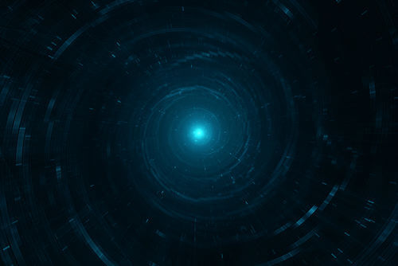
So far in this module we have mainly talked about studying and measuring the universe.
A consequence of the speed of light is that, as you look out into space, you begin to look further and further back in time.
But the history of the universe goes back further than we can see.

Slide 4
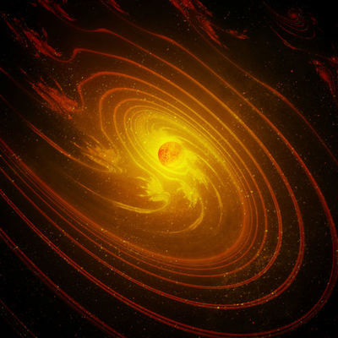
How do we know anything about the start of the universe, then?
There is enough data available for scientists to have put together several theories for how the universe began.
The most widely accepted theory is called the Big Bang Theory.

Slide 5

The theory of the Big Bang is very difficult to test, because it concerns events which happened in the past.
The evidence of the theory can be found by examining the universe to see if it is still expanding, and analysing very old light waves from the beginning of the universe.

Slide 6
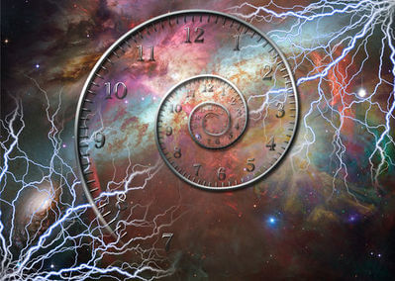
The Big Bang theory describes the development of the universe from a tiny point to the essentially infinite space we know today.
Let's travel about 14 billion years into the past to witness the big bang for ourselves.

Slide 7
Here we are at the beginning of everything!
At the moment we're outside of the universe to observe it as it grows. This is technically impossible but we should be fine if we don't think about it too much.
Now, you may be wondering, where is the universe?

Slide 8

There is a tiny speck right around here. We can't see it, but it's here somewhere. This speck is the universe!

Slide 9
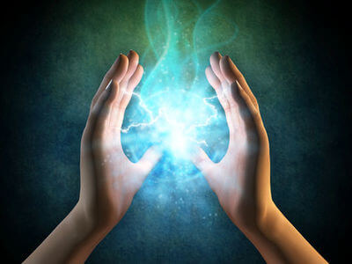
You may have heard of Einstein's famous equation E = mc² before.
E is energy, m is mass, and c is the speed of light.
The equation is stating that mass and energy are equivalent, and are related by the speed of light squared. So mass can turn into energy and energy can turn into mass.

Slide 10
This tiny ball of the universe is only energy right now.
We call this ball a singularity because it is condensed into a single point.
There isn't anything like space or time inside there at the moment. It's just endless energy in a tiny point.
And in a few moments it's going to start expanding.

Slide 11

We don't know why this happened.
The Big Bang theory doesn't try to explain it. This theory only covers what happens after the expansion begins.
Humans have so many different ideas about what started the universe. Some are religious, some are guesswork and some are scientific.

Slide 12
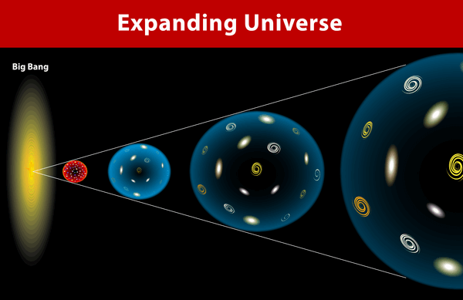
The show is about to start.
The Big Bang is an incredibly rapid expansion of the universe which takes place over billions of years. It would be incorrect to think of it as an explosion.
Rather it is more like inflating a balloon very very quickly.
But a lot of very important things happen over a very short period of time, so we're going to have to pay very close attention.

Slide 13
We have reached the beginning of the universe!
Since this is the beginning, let's call the time t=0. The universe is going to stay as a singularity for the first moment of its time.

Slide 14
The length of time where it stays as a singularity is called the Planck Epoch.
This epoch lasts for 1/10⁴³​ seconds, and is the smallest possible measure of time, called the Planck time.
This is equivalent to 0.0000000000000000000000000000000000000000001 s.

Slide 15
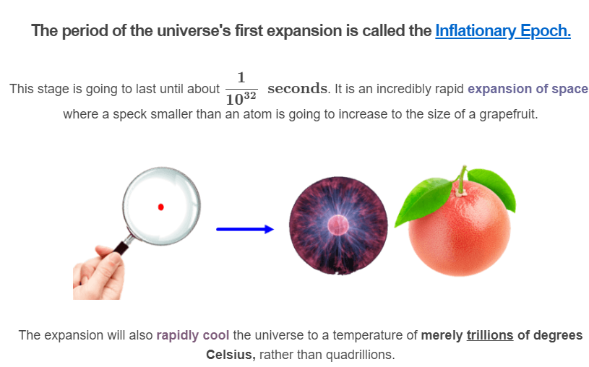

Slide 16

Right now, the universe is full of a hot dense plasma.
But that's about to change as we enter the next phase - the Quark Epoch.
The cooling of the universe means that the plasma is starting to clump together into particles. Electrons and other basic molecules form in this stage, as well as the quark.

Slide 17
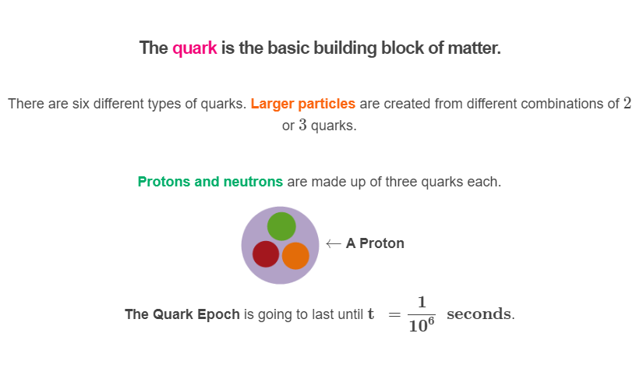

Slide 18
The universe is going to simply keep getting bigger over the rest of the first second.
By the time we reach t =1 seconds, it is over one trillion trillion km across.
The time until then is called the Hadron Epoch. The lower temperatures allow quarks to bond as protons and neutrons through nuclear fusion.
Hadrons are the name given to particles like protons and neutrons which are made up of quarks.

Slide 19
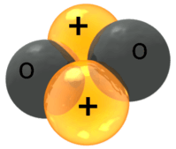
Just one second has passed, but we already have a universe filled with a mixture of electrons, neutrons and protons (along with other, stranger particles).
We are now in the Epoch of Nucleosynthesis. Neutrons and protons, gravitationally attracted to each other, are beginning to group together as nuclei.
Elements like hydrogen and helium have now been created - without any electrons attached.

Slide 20

At the end of nucleosynthesis, fusion stops across the universe because the universe's average energy has fallen below the energy for fusion.
The universe is about 75% hydrogen and 25% helium now. The other elements make up less than 1%.

Slide 21
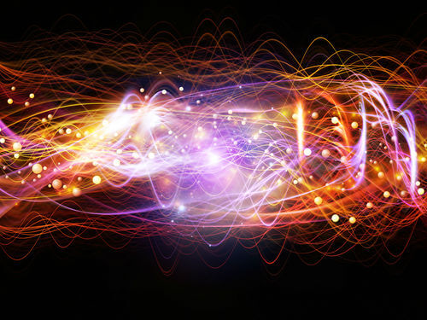
The universe is just going to grow without much change for the next 300,000 years.
It is filled with a soupy plasma of hydrogen nuclei, helium nuclei and electrons. Photons rebound around the particles, trapped by the free electrons - filling the universe with light.
This era is known as the Photon Epoch for this reason.

Slide 22
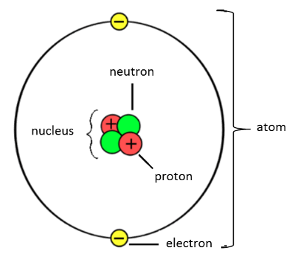
After a long time, 300,000 years to be exact, something has finally changed.
The universe is about one thousandth of its current size, and around 3000∘C.
At this temperature electrons can be captured by nuclei to form atoms. The bonding of electrons in turn frees the photons, allowing them to travel the universe.
Because light is no longer trapped, this moment is the first possible time we can observe directly. Some of this light is still hitting the Earth to this day.

Slide 23
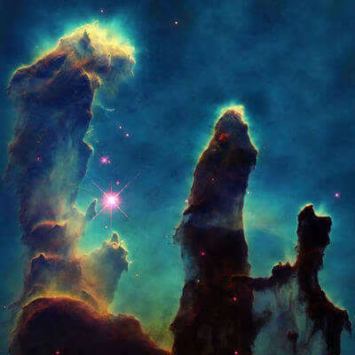
However, there is nothing around to produce light at the moment.
There aren't any stars yet. So we call this time the Dark Epoch.
Gravity pulls the matter across the universe into larger and larger clumps during this time. The first cosmic dust clouds and nebulae begin to form.
Stars are born from these nebulae. After 300 million years, we get the first galaxies.

Slide 24
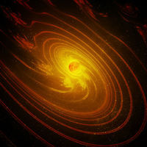
Around t = 5 billion years from the beginning, stars and dust gathered together to create the Milky Way galaxy.
If we travel down to one of its spiral arms, we can find a ball of gas which will eventually become our Sun. It will take another 4 billion years to make it and the solar system around it.
Our Earth is formed in this time. Now we just have to wait another 4.54 billion years until the present day.
And that is the story of the how the universe came to be.

Slide 25
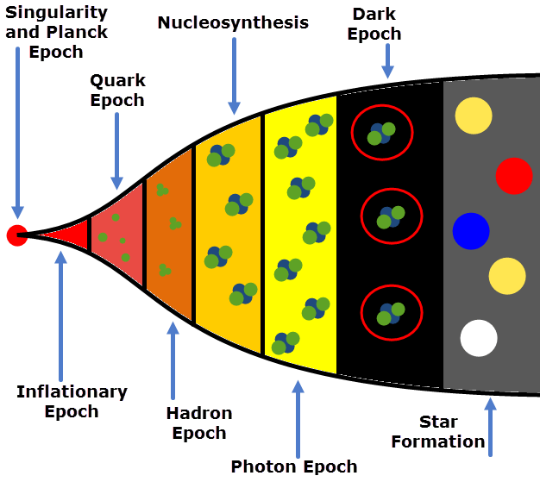
Here is a timeline of the Big Bang all in one place.

Slide 26
